Slide 1
Data Structures and Algorithms INFO-3135
(more) Linear Data Structures
Doubly-lined lists, queues, priority queues

Slide 2
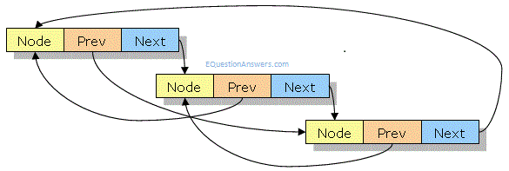
Double Linked List
Removing an element at the middle of a singly linked list is not easy as we need to find the node previous
It is time consuming to remove any node other than the head in a singly linked list – A double link list can help solve this
In addition to its data member, a node in a doubly linked list stores two pointers, a “next” pointer and a “prev” pointer, which point to the next node in the list and the previous node in the list
Now our linked list operations are more flexible and efficient

Slide 3
Queues
A queue is a collection whose elements are:
added at one end known as the rear or tail
removed from the other end known as the front or head
A queue is a FIFO structure (first in, first out)
Recall that a stack is a LIFO structure and has operations that take place only at the top
A queue has operations that take place at both ends
The following are queue operations
clear – clear the queue
isEmpty – check if there is anything waiting in the queue
enqueue – add an element to the rear (tail)
dequeue – remove an element from the front (head)
peek – return the first element without removing it

Slide 4
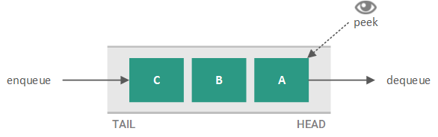
Uses for Queues
Managing transaction requests in a web application
A print queue – documents are handled first come first serve
A keyboard buffer

Slide 5
Linear List Operations
Array
size
empty
front
back
[ ]
Vector
size
empty
front
back
[ ]
push_back
pop_back
clear
insert
erase
Stack
size
empty
top
push
pop
peek
Queue
size
empty
front
back
enqueue
dequeue

Slide 6
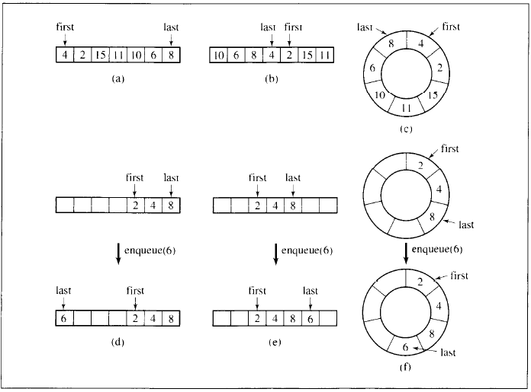
Implementing Queues
Queues can be implemented with arrays or linked lists.
We can use linear lists or circular lists
Generally, a circular queue requires three pointers:
one to the actual buffer in memory
one to point to the start of valid data
one to point to the end of valid data
Arrays are not the most efficient or practical
A doubly linked list would be the best approach

Slide 7
Priority Queues
Sometimes first in/first out scheduling needs to be overruled using some priority criteria
In a sequence p2 may have to be processed before p1.
In priority queues elements are dequeued according to their priority and their position in the queue
The challenge is finding a reasonably efficient algorithm for enqueuing and dequeuing.
We can use a linked list as an entry ordered queue (items are arranged by their entry into the queue) – adding is quick but removing is slower
or we can add elements to the queue based on their priority – removing is quick but adding is slow
Priority must result in a key value that can be sorted

Slide 8
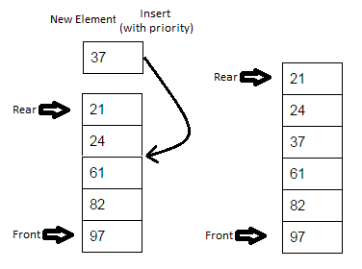
Priority Queue Operations
is_empty - check whether the queue has no elements.
insert_with_priority - add an element to the queue with an associated priority.
pull_highest_priority_element - remove the element from the queue that has the highest priority, and return it.
Peek – view the element with the highest priority but do not remove it

Slide 9
Priority Queues and Queuing theory
Queues are so commonly that a well-developed and mathematical theory of queues exists.
Various scenarios and models are created and analysed.
J.O. Hendriksen (1977 – 1983)
A simple linked list with an additional to the list to find a range of elements in which a new element should be included
Blackstone (1981)
A short ordered list and an unordered list and a threshold priority
Number of elements in the ordered list depend on priority
Some cases the ordered list could be empty
Elements in the ordered list have priority over a set threshold

Slide 10
Note about the “internals”
We’ve implemented queues using linked lists.
That’s because that’s the simplest and traditional way to do it.
But you don’t have to do it that way.
You could do it where the “internals” are an array or some other sort of thing, so long as it behaves like a list.

